Slide 1

ABFRL Brands-Login/Sign-up Flow iOS/Android Tagging
11th October 2023

Slide 2
Guidelines to Implement Tagging
Adobe Launch SDK should be installed before the custom tagging.
Copy and paste the keys of contextData as it is without changing the Camel Casing.
Context Data should be along with calling the Track State and Track Action functions.
<> this indicates dynamic value to be captured and passed.
Icid will be added to the next page’s URL where user lands after clicking any content of current page.
Testing will be performed by Implementation Team after ABFRL QA team will give the confirmation/sign off for the testing done by them.
UAT should be done first in staging and then in production post production UAT adobe’s codes are pushed to live.
For Customer ID, pass the value only when available else pass it as blank.

Slide 3
Super App Brands
Since Super App contains multiple cross-brands journey, therefore w.r.t to tracking the brand/product brand currently included( PFB the table with the expected value to be passed in the context data)
Brand/Product Brand | Datalayer Value
Van Huesen | vh
Peter England | pe
Allen Solly | as
Louis Phillipe | lp
Reebok | reebok
American Eagle | aeo
Forever 21 | f21
Simon Carter | sc

Slide 4
Standard Login/Sign Up Flow

Slide 5
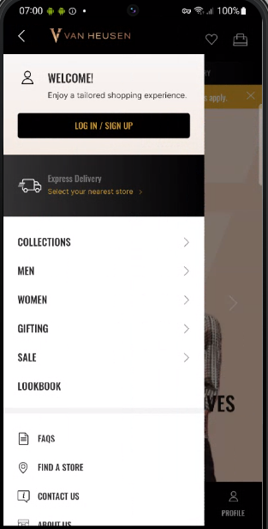
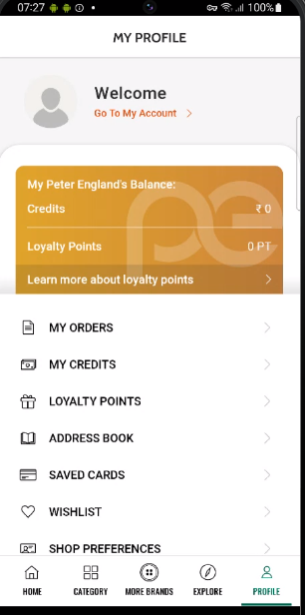
On click on login/sign up

Slide 6
Click type | Tracking type | Launch variables | Expected values
Login/Sign up | button | let contextData={ linkName: “login/sign up", channel: "<android/ios>|<current page name>", // for page name pass name of the page from which user clicks linkPageName: “<current page name>", // pass name of the page from which user clicks customerID : "<customerID>", // only pass when available loginStatus : "<logged-in/guest>" , platform: "<android/ios>", userDetails: "<gender>|<age>", // pass only when user is logged in dob: "<date of birth>" // pass only when user is logged in }; ACPCore.trackAction(“login/sign up", contextData); | loginStatus may have the values:- logged-in Guest

Slide 7
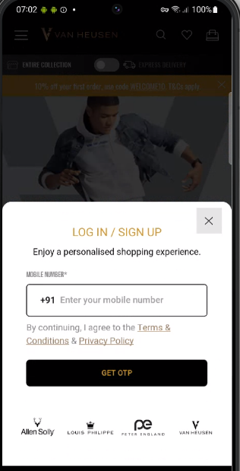
On load of login/sign up modal

Slide 8
Page type | Tracking type | Launch variables | Expected values
Login/Sign up | On load | let contextData={ pageName: “login/sign up page", channel: "<android/ios>|login/sign up", parentPage: “<page name>", // pass name of the page on which pop-up loads customerID : "<customerID>", // only pass when available loginStatus : "<logged-in/guest>" , pageType : “login/sign up page”, platform: "<android/ios>", userDetails: "<gender>|<age>", // pass only when user has logged in dob: "<date of birth>" // pass only when user is logged in // pass only when user has logged in }; ACPCore.trackState(“login/sign up page", contextData); | loginStatus may have the values:- logged-in Guest parentPage may have values:- Home page Category page Product listing page etc

Slide 9
On click of multiple CTA’s

Slide 10
Click type | Tracking type | Launch variables | Expected values
All CTAs | button | let contextData={ linkName:“<cta name>", channel: “<android/ios>|login/sign up”, linkPageName: “login/sign up page", customerID : "<customerID>", // only pass when available loginStatus : "<logged-in/guest>" , platform: "<android/ios>", userDetails: "<gender>|<age>", // pass only when user is logged in dob: "<date of birth>" // pass only when user is logged in }; ACPCore.trackAction(“<cta name>", contextData); | loginStatus may have the values:- logged-in Guest Cta name will have 1. get otp 2. allen solly icon 3. close 4. van Heusen icon, etc.

Slide 11
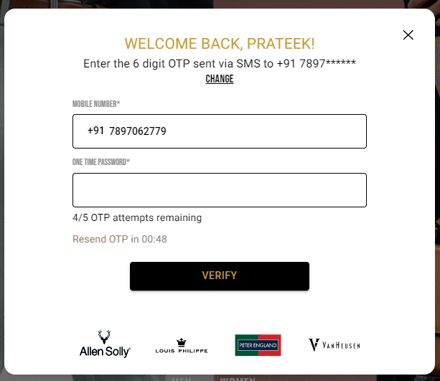
On load of enter otp

Slide 12
Page type | Tracking type | Launch variables | Expected values
Enter OTP | Page load | let contextData={ pageName: “enter otp page", channel: "<android/ios>|login/sign up", customerID : "<customerID>", // only pass when available loginStatus : "<logged-in/guest>" , pageType : “enter otp page”, platform: "<android/ios>", userDetails: "<gender>|<age>", // pass only when user has logged in dob: "<date of birth>" // pass only when user is logged in // pass only when user has logged in }; ACPCore.trackState(“enter otp page", contextData); | loginStatus may have the values:- logged-in Guest

Slide 13
On click of multiple CTAs

Slide 14
click type | Tracking type | Launch variables | Expected values
All CTAs | button | let contextData={ linkName:“<cta name>", channel: "<android/ios>|login/sign up", linkPageName: “enter otp page", customerID : "<customerID>", // only pass when available loginStatus : "<logged-in/guest>" , platform: "<android/ios>", userDetails: "<gender>|<age>", // pass only when user is logged in dob: "<date of birth>”, // pass only when user is logged in loginMethod: “login with otp”, Additional parameters &&events: “<event45/event46>”, // In case when on click of verify the user has successfully logged-in pass event45, In case when on click of verify the user has not successfully logged-in pass event46 error : “< error >” // error to be passed only in case of login failure ( incorrect otp will not be counted as error only UI or Backend error). }; ACPCore.trackAction(“<cta name>", contextData); | loginStatus may have the values:- logged-in Guest Cta name will have 1. verify 2. change mobile number 3. resend otp 3. allen solly icon 4. van Heusen icon 5. close, etc.

Slide 15
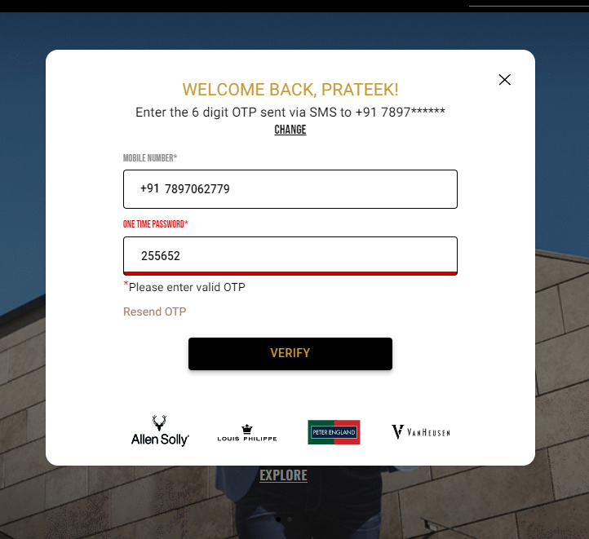
On load of incorrect entered otp

Slide 16
Page type | Tracking type | Launch variables | Expected values
Incorrect OTP | Page load | let contextData={ pageName: “incorrect otp page", channel: "<android/ios>|login/sign up", customerID : "<customerID>", // only pass when available loginStatus : "<logged-in/guest>" , pageType : “incorrect otp page”, platform: "<android/ios>", userDetails: "<gender>|<age>", // pass only when user has logged in dob: "<date of birth>" // pass only when user is logged in // pass only when user has logged in }; ACPCore.trackState(“incorrect otp page", contextData); | loginStatus may have the values:- logged-in Guest

Slide 17
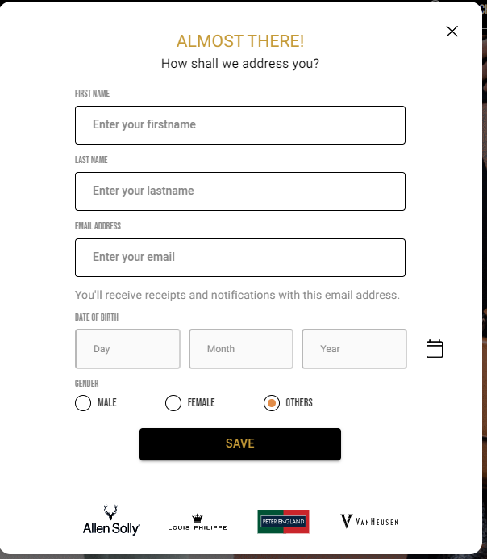
On load of user registration page

Slide 18
Page type | Tracking type | Launch variables | Expected values
Incorrect OTP | Page load | let contextData={ pageName: “user registration page", channel: "<android/ios>|login/sign up", customerID : "<customerID>", // only pass when available loginStatus : "<logged-in/guest>" , pageType : “user registration page”, platform: "<android/ios>", userDetails: "<gender>|<age>", // pass only when user has logged in dob: "<date of birth>" // pass only when user is logged in // pass only when user has logged in }; ACPCore.trackState(“user registration page", contextData); | loginStatus may have the values:- logged-in Guest

Slide 19
On click of multiple CTAs

Slide 20
click type | Tracking type | Launch variables | Expected values
All CTAs | button | let contextData={ linkName:“<cta name>", channel: "<android/ios>|login/sign up", linkPageName: “user registration page", customerID : "<customerID>", // only pass when available loginStatus : "<logged-in/guest>" , platform: "<android/ios>", userDetails: "<gender>|<age>", // pass only when user is logged in dob: "<date of birth>”, // pass only when user is logged in Additional parameters &&events: “<event47/event48>”, //In case when on click of save the user has successfully registered, pass event47. In case when on click of save the user has not successfully registered, pass event48 error : “< error >” // error to be passed only in case of login failure ( incorrect otp will not be counted as error only UI or Backend error). }; ACPCore.trackAction(“<cta name>", contextData); | loginStatus may have the values:- logged-in Guest Cta name will have 1. save 2. allen solly icon 3. van Heusen icon, etc.

Slide 21
Cart Checkout Login/Sign Up Flow

Slide 22
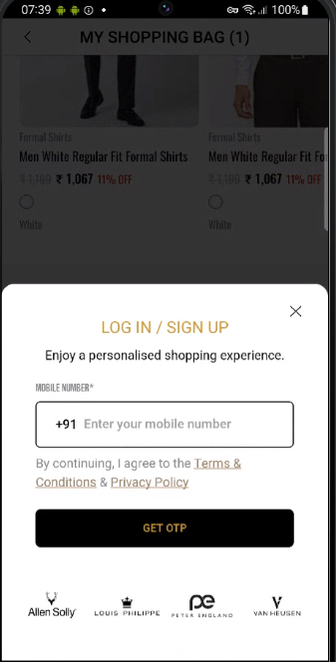
On load of login/sign up via cart checkout

Slide 23
Page type | Tracking type | Launch variables | Expected values
Login/Sign up | On load | let contextData={ pageName: “login/sign up page", parentPage: “checkout page", channel: "<android/ios>|checkout", customerID : "<customerID>", // only pass when available loginStatus : "<logged-in/guest>" , pageType : “login/sign up page”, platform: "<android/ios>", userDetails: "<gender>|<age>", // pass only when user has logged in dob: "<date of birth>" // pass only when user is logged in // pass only when user has logged in }; ACPCore.trackState(“login/sign up page", contextData); | loginStatus may have the values:- logged-in Guest

Slide 24
On click of multiple CTA’s

Slide 25
Click type | Tracking type | Launch variables | Expected values
All CTAs | button | let contextData={ linkName:“<cta name>", channel: "<android/ios>|checkout", linkPageName: “login/sign up page", customerID : "<customerID>", // only pass when available loginStatus : "<logged-in/guest>" , platform: "<android/ios>", userDetails: "<gender>|<age>", // pass only when user is logged in dob: "<date of birth>" // pass only when user is logged in }; ACPCore.trackAction(“<cta name>", contextData); | loginStatus may have the values:- logged-in Guest Cta name will have 1. get otp 2. allen solly icon 3. van Heusen icon, etc.

Slide 26
On load of enter otp

Slide 27
Page type | Tracking type | Launch variables | Expected values
Enter OTP | Page load | let contextData={ pageName: “enter otp page", channel: "<android/ios>|checkout", customerID : "<customerID>", // only pass when available loginStatus : "<logged-in/guest>" , pageType : “enter otp page”, platform: "<android/ios>", userDetails: "<gender>|<age>", // pass only when user has logged in dob: "<date of birth>" // pass only when user is logged in // pass only when user has logged in }; ACPCore.trackState(“enter otp page", contextData); | loginStatus may have the values:- logged-in Guest

Slide 28
On click of multiple CTAs

Slide 29
click type | Tracking type | Launch variables | Expected values
All CTAs | button | let contextData={ linkName:“<cta name>", channel: "<android/ios>|checkout", linkPageName: “enter otp page", customerID : "<customerID>", // only pass when available loginStatus : "<logged-in/guest>" , platform: "<android/ios>", userDetails: "<gender>|<age>", // pass only when user is logged in dob: "<date of birth>”, // pass only when user is logged in loginMethod: “login with otp” Additional parameters &&events: “<event45/event46>”, // In case when on click of verify the user has successfully logged-in pass event45, In case when on click of verify the user has not successfully logged-in pass event46 error : “< error >” // error to be passed only in case of login failure ( incorrect otp will not be counted as error only UI or Backend error). }; ACPCore.trackAction(“<cta name>", contextData); | loginStatus may have the values:- logged-in Guest Cta name will have 1. verify 2. change mobile number 3. resend otp 3. allen solly icon 4. van Heusen icon, etc.

Slide 30
On load of incorrect entered otp

Slide 31
Page type | Tracking type | Launch variables | Expected values
Incorrect OTP | Page load | let contextData={ pageName: “incorrect otp page", channel: "<android/ios>|checkout", customerID : "<customerID>", // only pass when available loginStatus : "<logged-in/guest>" , pageType : “incorrect otp page”, platform: "<android/ios>", userDetails: "<gender>|<age>", // pass only when user has logged in dob: "<date of birth>" // pass only when user is logged in // pass only when user has logged in }; ACPCore.trackState(“incorrect otp page", contextData); | loginStatus may have the values:- logged-in Guest

Slide 32
On load of user registration page

Slide 33
Page type | Tracking type | Launch variables | Expected values
Incorrect OTP | Page load | let contextData={ pageName: “user registration page", channel: "<android/ios>|checkout", customerID : "<customerID>", // only pass when available loginStatus : "<logged-in/guest>" , pageType : “user registration page”, platform: "<android/ios>", userDetails: "<gender>|<age>", // pass only when user has logged in dob: "<date of birth>" // pass only when user is logged in // pass only when user has logged in }; ACPCore.trackState(“user registration page", contextData); | loginStatus may have the values:- logged-in Guest

Slide 34
On click of multiple CTAs

Slide 35
click type | Tracking type | Launch variables | Expected values
All CTAs | button | let contextData={ linkName:“<cta name>", channel: "<android/ios>|checkout", linkPageName: “user registration page", customerID : "<customerID>", // only pass when available loginStatus : "<logged-in/guest>" , platform: "<android/ios>", userDetails: "<gender>|<age>", // pass only when user is logged in dob: "<date of birth>”, // pass only when user is logged in Additional parameters &&events: “<event47/event48>”, //In case when on click of save the user has successfully registered, pass event47. In case when on click of save the user has not successfully registered, pass event48 error : “< error >” // error to be passed only in case of registration failure (only UI or Backend error). }; ACPCore.trackAction(“<cta name>", contextData); | loginStatus may have the values:- logged-in Guest Cta name will have 1. save 2. allen solly icon 3. van Heusen icon, etc.

Slide 36
Empty Cart Login/Sign Up Flow

Slide 37
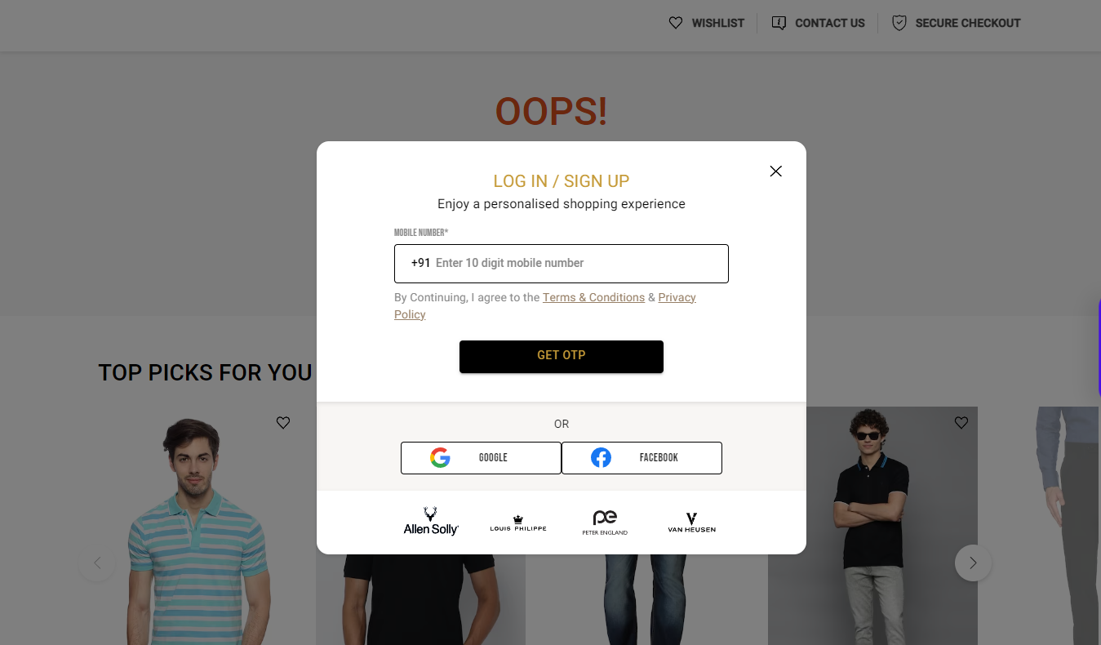
On load of login/sign up via empty cart

Slide 38
Page type | Tracking type | Launch variables | Expected values
Login/Sign up | On load | let contextData={ pageName: “login/sign up page", parentPage: “empty cart page", channel: "<android/ios>|cart", customerID : "<customerID>", // only pass when available loginStatus : "<logged-in/guest>" , pageType : “login/sign up page”, platform: "<android/ios>", userDetails: "<gender>|<age>", // pass only when user has logged in dob: "<date of birth>" // pass only when user is logged in // pass only when user has logged in }; ACPCore.trackAction(“login/sign up page", contextData); | loginStatus may have the values:- logged-in Guest

Slide 39
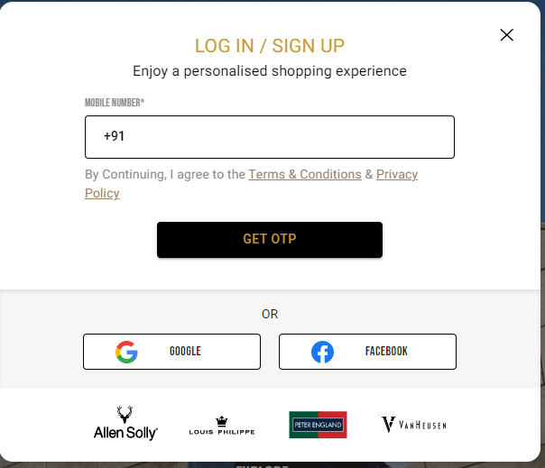
On click of multiple CTA’s

Slide 40
Click type | Tracking type | Launch variables | Expected values
All CTAs | button | let contextData={ linkName:“<cta name>", channel: "<android/ios>|cart", linkPageName: “login/sign up page", customerID : "<customerID>", // only pass when available loginStatus : "<logged-in/guest>" , platform: "<android/ios>", userDetails: "<gender>|<age>", // pass only when user is logged in dob: "<date of birth>" // pass only when user is logged in //Additional parameter, when user tries to login with Google or facebook loginMethod: “<login method>” }; ACPCore.trackAction(“<cta name>", contextData); | loginStatus may have the values:- logged-in Guest Cta name will have 1. get otp 2. login with google 3. Login with facebook 4. allen solly icon 5. van Heusen icon, etc. loginMethod will have login with google login with facebook

Slide 41
On load of enter otp

Slide 42
Page type | Tracking type | Launch variables | Expected values
Enter OTP | Page load | let contextData={ digitalData={ pageName: “enter otp page", channel: "<android/ios>|cart", customerID : "<customerID>", // only pass when available loginStatus : "<logged-in/guest>" , pageType : “enter otp page”, platform: "<android/ios>", userDetails: "<gender>|<age>", // pass only when user has logged in dob: "<date of birth>" // pass only when user is logged in // pass only when user has logged in }; ACPCore.trackAction(“enter otp page", contextData); | loginStatus may have the values:- logged-in Guest

Slide 43
On click of multiple CTAs

Slide 44
click type | Tracking type | Launch variables | Expected values
All CTAs | button | let contextData={ linkName:“<cta name>", channel: "<android/ios>|cart", linkPageName: “enter otp page", customerID : "<customerID>", // only pass when available loginStatus : "<logged-in/guest>" , platform: "<android/ios>", userDetails: "<gender>|<age>", // pass only when user is logged in dob: "<date of birth>”, // pass only when user is logged in loginMethod: “login with otp” Additional parameters &&events: “<event47/event48>”, //In case when on click of save the user has successfully registered, pass event47. In case when on click of save the user has not successfully registered, pass event48 error : “< error >” // error to be passed only in case of login failure ( incorrect otp will not be counted as error only UI or Backend error). }; ACPCore.trackAction(“<cta name>", contextData); | loginStatus may have the values:- logged-in Guest Cta name will have 1. verify 2. change mobile number 3. resend otp 3. allen solly icon 4. van Heusen icon, etc.

Slide 45
On load of incorrect entered otp

Slide 46
Page type | Tracking type | Launch variables | Expected values
Incorrect OTP | Page load | let contextData={ pageName: “incorrect otp page", channel: "<android/ios>|cart", customerID : "<customerID>", // only pass when available loginStatus : "<logged-in/guest>" , pageType : “incorrect otp page”, platform: "<android/ios>", userDetails: "<gender>|<age>", // pass only when user has logged in dob: "<date of birth>" // pass only when user is logged in // pass only when user has logged in }; ACPCore.trackAction(“incorrect otp page", contextData); | loginStatus may have the values:- logged-in Guest

Slide 47
On load of user registration page

Slide 48
Page type | Tracking type | Launch variables | Expected values
Incorrect OTP | Page load | let contextData={ pageName: “user registration page", channel: "<android/ios>|cart", customerID : "<customerID>", // only pass when available loginStatus : "<logged-in/guest>" , pageType : “user registration page”, platform: "<android/ios>", userDetails: "<gender>|<age>", // pass only when user has logged in dob: "<date of birth>" // pass only when user is logged in // pass only when user has logged in }; ACPCore.trackAction(“user registration page", contextData); | loginStatus may have the values:- logged-in Guest

Slide 49
On click of multiple CTAs

Slide 50
click type | Tracking type | Launch variables | Expected values
All CTAs | button | let contextData={ linkName:“<cta name>", channel: "<android/ios>|cart", linkPageName: “user registration page", customerID : "<customerID>", // only pass when available loginStatus : "<logged-in/guest>" , platform: "<android/ios>", userDetails: "<gender>|<age>", // pass only when user is logged in dob: "<date of birth>”, // pass only when user is logged in &&events: “<event47/event48>”, //In case when on click of save the user has successfully registered, pass event47. In case when on click of save the user has not successfully registered, pass event48 error : “< error >” // error to be passed only in case of registration failure (only UI or Backend error). }; ACPCore.trackAction(“<cta name>", contextData); | loginStatus may have the values:- logged-in Guest Cta name will have 1. save 2. allen solly icon 3. van Heusen icon, etc.

